Slide 1
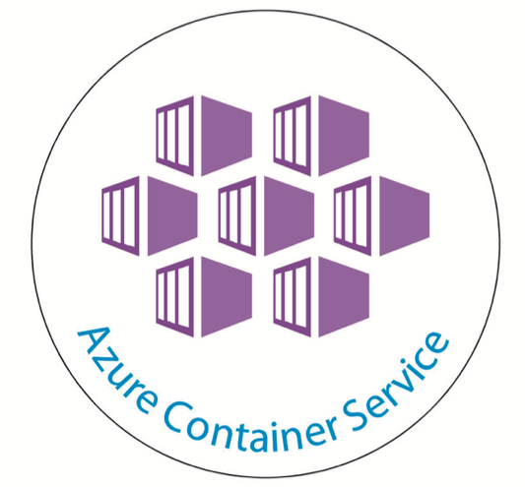
Containerize .Net Applications in Azure

Slide 2
Overview of .NET release history
Version Number | CLR/CLI Version | Release Date | Support Ended | Development tool | Included in |  | Replaces
 |  |  |  |  | Windows | Windows Server
1.0 | 1.0 | 2002-02-13 | 2009-07-14 | Visual Studio .NET | XP | N/A | N/A
1.1 | 1.1 | 2003-04-24 |  | Visual Studio .NET 2003 | N/A | 2003 | 1.0
2.0 | 2.0 | 2005-11-07 | 2011-07-12 | Visual Studio 2005 | N/A | 2003, 2003 R2, 2008 R2 SP1 | N/A
3.0 | 2.0 | 2006-11-06 | 2011-07-12 | Expression Blend | Vista | 2008 SP2, 2008 R2 SP1 | 2.0
3.5 | 2.0 | 2007-11-19 | 2011-07-12 | Visual Studio 2008 | 7, 8, 8.1, 10 | 2008 R2 SP1 | 2.0, 3.0
4.0 | 4 | 2010-04-12 | 2016-01-12 | Visual Studio 2010 | N/A | N/A | N/A
4.5 | 4 | 2012-08-15 | 2016-01-12 | Visual Studio 2012 | 8 | 2012 | 4.0
4.5.1 | 4 | 2013-10-17 | 2016-01-12 | Visual Studio 2013 | 8.1 | 2012 R2 | 4.0, 4.5
4.5.2 | 4 | 2014-05-05 | N/A | N/A | N/A | N/A | 4.0–4.5.1
4.6 | 4 | 2015-07-20 | N/A | Visual Studio 2015 | 10 | N/A | 4.0–4.5.2
4.6.1 | 4 | 2015-11-30 | N/A | Visual Studio 2015 Update 1 | 10 | N/A | 4.0–4.6
4.6.2 | 4 | 2016-08-02 | N/A |  | 10 | 2016 | 4.0–4.6.1
4.7 | 4 | 2017-04-05 | N/A | Visual Studio 2017 | 10 | N/A | 4.0–4.6.2
4.7.1 | 4 | 2017-10-17 | N/A | Visual Studio 2017 | 10 | N/A | 4.0–4.7
.Net Core 1, 1.1 | .NET Core SDK | 2016-06-27, 2016-11-16 | N/A | Visual Studio 2017 | 10 | N/A | 4.0-4.7.1
.Net Core 2 | .NET Core SDK | 2017-08-14 | N/A | Visual Studio 2017 | 10 | N/A | 4.0- Core 1.1

Slide 3
Why Docker is Required
Because Microsoft .NET Framework has successful application platform for last 15 years
Countless business-critical apps are running on older versions of the Framework and older versions of Windows Server.
Difficult to maintain, upgrade, extend and manage.
Need huge investment for full rewrite.
Where Docker Fits in .NET Solutions
With Docker, a platform is a lightweight containers, and Windows Server 2016/Linux
Adds new features like monitoring, increases security and performance
Supports Continuous deployment that reduces need of lengthy and expensive rebuilds.
Supports server based applications like WCF, .NET console apps and all flavors of ASP.NET, APIs, messaging solutions and other components that run in the background like databases.
Where Dockers Continuous Deployment Fails
In desktop apps like Windows Forms or WPF apps because there’s no UI integration between the Docker platform and the Windows host.
But, docker provides provision of using Image2Docker, lift and shift for Desktop applications.
Questions?
PAAS also supports continuous Integration and delivery? There also security, monitoring , performance.
IAAS helps to configure our own infrastructure with security and less cost
Then why to go with dockers?
Simple Answer
There is No code change to legacy applications
Also, added extra features like security, performance, scaling and monitoring etc
Simplicity of Docker
Only a small script called a Dockerfile is required that automates all the steps for deploying the app.

Slide 4
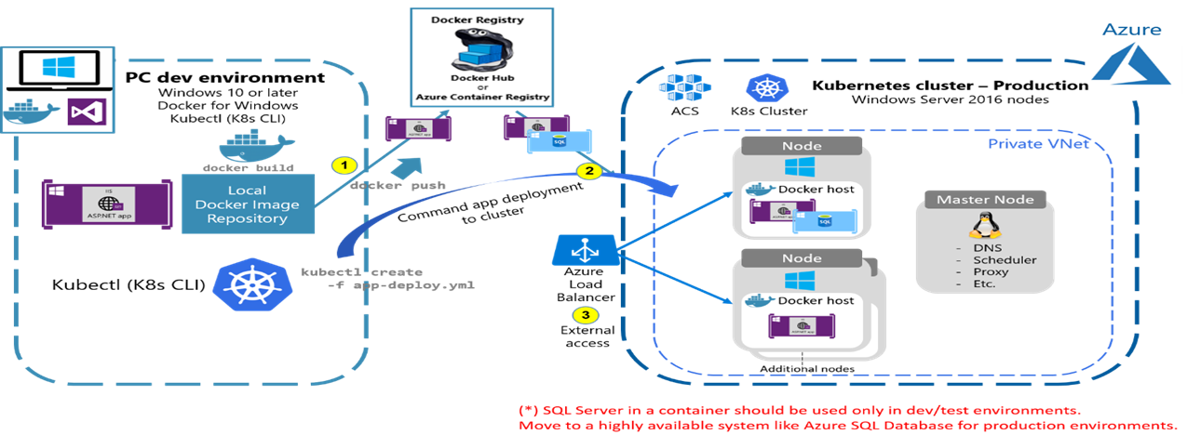
Process of moving to Container
Build Image
Push Image to Registry
Pull Image from Registry to cluster

Slide 5
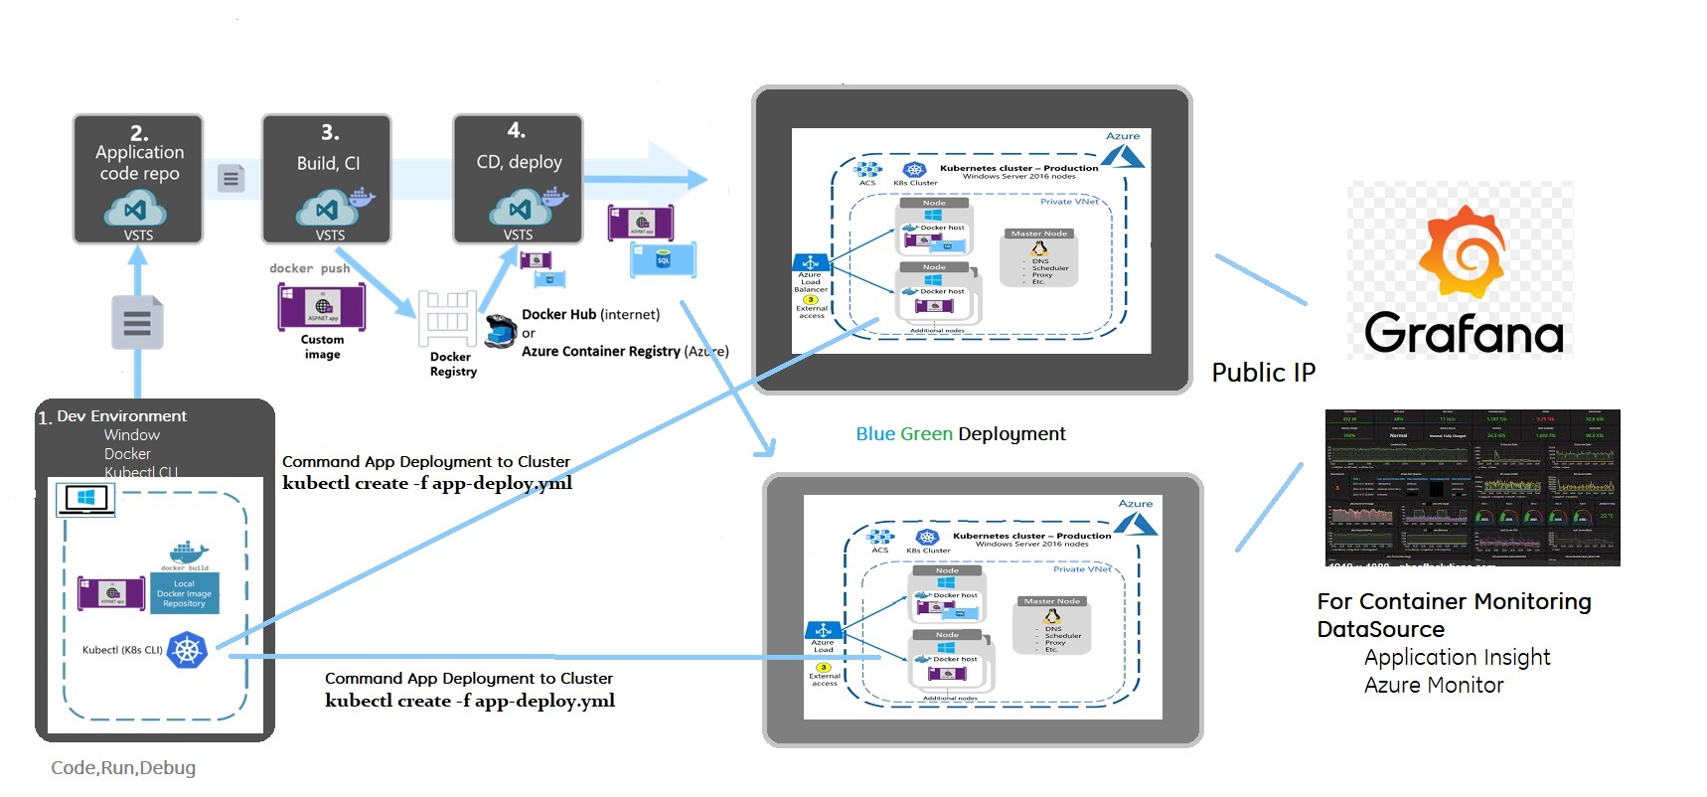

Slide 6
Docker Support
Version Number | Type of Docker Support | Methods | Servers Supported | Dockers On Premises | Kubernetes Cluster
1.0 | Lift & Shift | Image2Docker | Same Infra | Nothing | Kubernetes on Windows/Linux
1.1 | Lift & Shift | Image2Docker | Same Infra | Nothing | Kubernetes on Windows/Linux
2.0 | Lift & Shift | Image2Docker | Same Infra | Nothing | Kubernetes on Windows/Linux
3.0 | Lift & Shift | Image2Docker | Same Infra | Nothing | Kubernetes on Windows/Linux
3.5 | Lift & Shift | Image2Docker | Same Infra | Nothing | Kubernetes on Windows/Linux
4.0 | CI/CD | VSTS, Jenkins | Windows Server 2016 | Docker to Windows | Kubernetes on Windows
4.5 | CI/CD | VSTS, Jenkins | Windows Server 2016 | Docker to Windows | Kubernetes on Windows
4.5.1 | CI/CD | VSTS, Jenkins | Windows Server 2016 | Docker to Windows | Kubernetes on Windows
4.5.2 | CI/CD | VSTS, Jenkins | Windows Server 2016 | Docker to Windows | Kubernetes on Windows
4.6 | CI/CD | VSTS, Jenkins | Windows Server 2016 | Docker to Windows | Kubernetes on Windows
4.6.1 | CI/CD | VSTS, Jenkins | Windows Server 2016 | Docker to Windows | Kubernetes on Windows
4.6.2 | CI/CD | VSTS, Jenkins | Windows Server 2016 | Docker to Windows | Kubernetes on Windows
4.7 | CI/CD | VSTS, Jenkins | Windows Server 2016 | Docker to Windows | Kubernetes on Windows
4.7.1 | CI/CD | VSTS, Jenkins | Windows Server 2016 | Docker to Windows | Kubernetes on Windows
.Net Core 1, 1.1 | CI/CD | VSTS, Jenkins | Linux/Windows Server 2016 | Docker to Linux/Windows | Kubernetes on Windows/Linux
.Net Core 2 | CI/CD | VSTS, Jenkins | Linux/Windows Server 2016 | Docker to Linux/Windows | Kubernetes on Windows/Linux

Slide 7
For .Net Framework 1.0 to 3.5, Using Image2Docker to deploy to ACS
In PowerShell, just type:
It gives access to Get-WindowsArtifacts and ConvertTo-Dockerfile
Currently Image2Docker supports VHD, VHDK, and WIM images.
If you have a VMDK, Microsoft provides a great conversion tool to convert VMDK images to VHD images.
Install-Module –Name Image2Docker
Import-Module Image2Docker
# List out supported artifacts
Get-WindowsArtifact
# Extract a single wesbite from an IIS virtual machine and OutputPath to c:\i2d2
ConvertTo-Dockerfile -ImagePath c:\vms\iis.vhd -Artifact IIS -ArtifactParam aspnet-webapi -OutputPath c:\i2d2
# Change drive to
cd c:\i2d2
#Build Image
docker build -t aspnet-webapi .
#Run Image on local docker
docker run -d -p 80:80 aspnet-webapi
#Tag image to make it registry ready
Docker tag aspnet-webapi dockerciregistry.azurecr.io/aspnet-webapi:initial
#Login ACR
Docker login dockerciregistry.azurecr.io ( ask for username and password)
# Push Image to ACR
Docker push dockerciregistry.azurecr.io/aspnet-webapi:initial
# Deploy to kubernetes
kubectl create -f deployment.yml

Slide 8
To Create Kubernetes Cluster on windows for .Net 4 to 4.7.1
#Create Resource Group
az group create --name myResourceGroup --location eastus
# Create ACS with Kubernete Orchestrator
az acs create --orchestrator-type=kubernetes --resource-group myResourceGroup --name=myK8sCluster --agent-count=2 --generate-ssh-keys --windows --admin-username azureuser --admin-password myPassword12
To Create Kubernetes on Linux for .Net Core
az acs create --orchestrator-type kubernetes --resource-group myResourceGroup --name myK8sCluster --generate-ssh-keys
To connect with Kubernete cluster on Azure from client
az acs kubernetes install-cli
az acs kubernetes get-credentials --resource-group=myResourceGroup --name=myK8sCluster
Kubectl proxy
Container Registry
# Create resource group
New-AzureRmResourceGroup -Name myResourceGroup -Location EastUS
# Create Registry
$registry = New-AzureRMContainerRegistry -ResourceGroupName "myResourceGroup" -Name "myContainerRegistry007" -EnableAdminUser -Sku Basic
# Get Username and Password of Registry
$creds = Get-AzureRmContainerRegistryCredential -Registry $registry
# Login to ACR
docker login $registry.LoginServer -u $creds.Username -p $creds.Password

Slide 9
For .Net Framework 4.0 to 4.7.1, prerequisites for deployment to ACS
Visual Studio Studio 2017
Docker for Windows
Kubernetes cluster
Container Registry
Dockerfile
Deployment file
SQL Deployment – Migrate SQL to Azure SQL
FROM microsoft/aspnet:4.7
ARG source
WORKDIR /inetpub/wwwroot
COPY ${source:-obj/Docker/publish} .

Slide 10
For .Net Core 1.1 to 2.0 Prequisites for Deployment to Azure
Visual Studio Studio 2017
Docker for Linux
Kubernetes cluster
Container Registry
Dockerfile
FROM microsoft/aspnetcore:2.0 AS base
WORKDIR /app
EXPOSE 80
FROM microsoft/aspnetcore-build:2.0 AS build-env
WORKDIR /app
# Copy csproj and restore as distinct layers
COPY *.csproj ./
RUN dotnet restore
# Copy everything else and build
COPY . ./
RUN dotnet publish -c Release -o out
# Build runtime image
FROM microsoft/aspnetcore:2.0
WORKDIR /app
COPY --from=build-env /app/out .
ENTRYPOINT ["dotnet", "FinalCore.dll"]

Slide 11
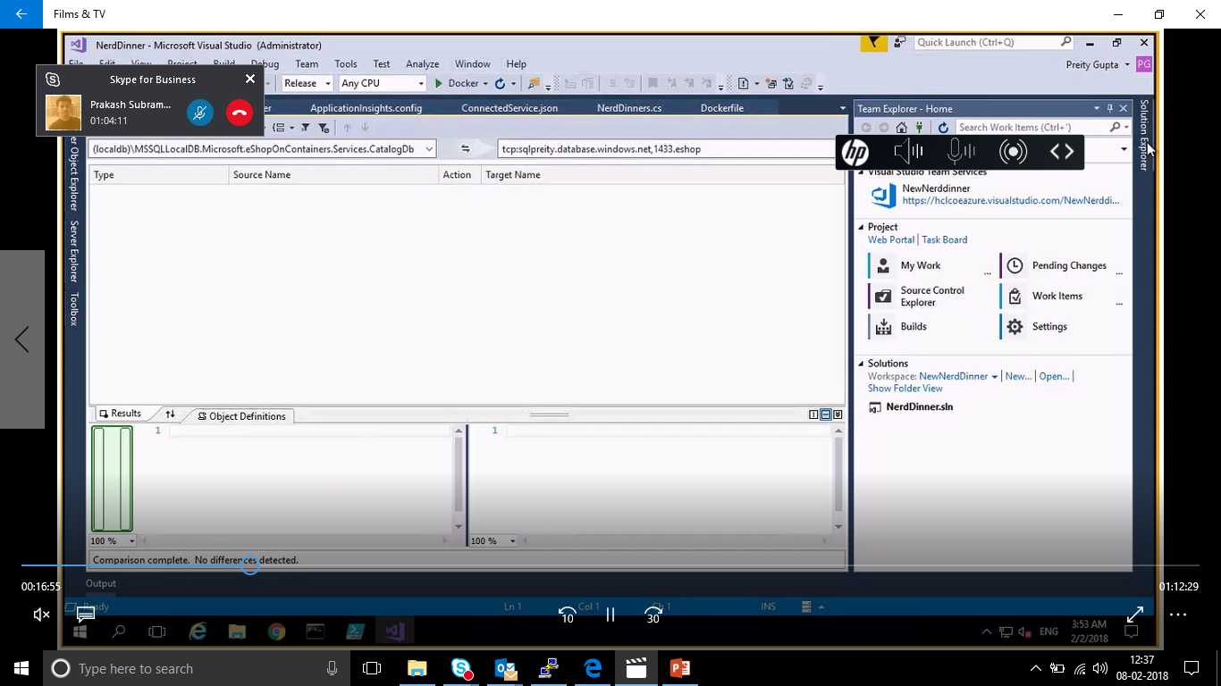
Blue Green Deployment
Monitoring
SQL

Slide 12
Thank You

